Slide 1
DATA SCIENCE Class 1: Intro to Data Science

Slide 2
i. WHAT IS A DATA SCIENTIST? Ii. How Data Scientists Add Value IIi. the Data Mining Workflow Iv. Qualities of a good Data Scientist
AGENDA

Slide 3
i. WHAT is A Data Scientist?
INTRO TO DATA SCIENCE
Notes:
~15-20 min for this section?

Slide 4
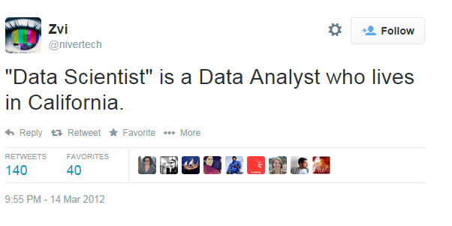
WHAT IS A DATA SCIENTIST?
Notes:
~15-20 min for this section?

Slide 5
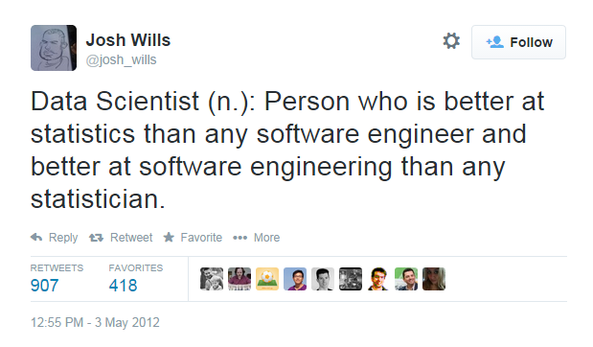
WHAT IS A DATA SCIENTIST?
Notes:
~15-20 min for this section?

Slide 6
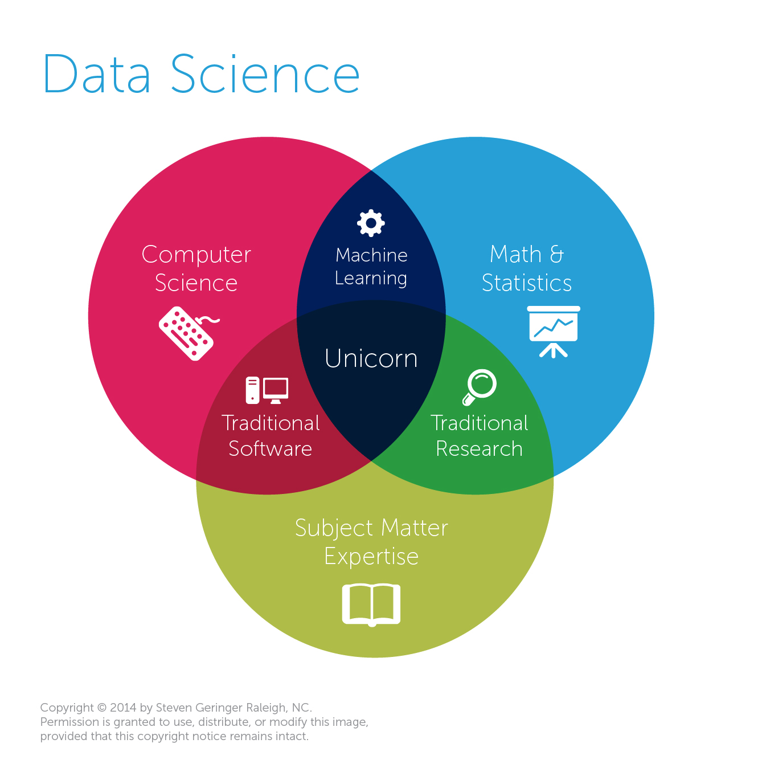
WHAT IS A DATA SCIENTIST?
Data Scientists are currently defined more by their set of skills than they type of work they do.
Data Science is a direct byproduct of tech companies’ desire to expand the role of engineering to other parts of their business.
Notes:
~15-20 min for this section?

Slide 7
WHAT MAKES A DATA SCIENTIST DIFFERENT FROM A DATA ANALYST?
Data Scientists typically have degrees or training in econometrics, applied math, and statistics.
Data Scientists develop rigorous, reproducible approaches.
Data Scientists work with tools and technologies typically reserved for software engineers.
Data Scientists develop predictive models that automatically take action on new data, without the need for human interaction.
Notes:
~15-20 min for this section?

Slide 8
I. How Data Scientists Add Value
INTRO TO DATA SCIENCE
Notes:
~15-20 min for this section?

Slide 9
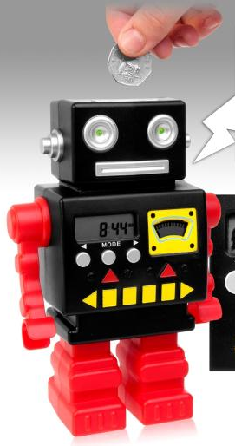
HOW DATA SCIENTISTS ADD VALUE
Data mining techniques generally add value by doing one of four things:
Predicting the bad
Identifying the good
Automating existing processes
Identifying patterns in data
Data scientists can be found within many fields. let’s look at some additional examples to motivate this course.
Notes:
Lots of names you’d expect (also obama, nyt → politics = growth area)
Q: can you think of any others? → show some example in the browser
Soon the question will be: who doesn’t use data science?

Slide 10
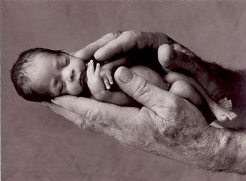
Example #1: Predicting Neonatal Infection
Problem: Children born prematurely are at high risk of developing infections, many of which are not detected until after the baby is sick
Goal: Detect subtle patterns in the data that predicts infection before it occurs
Data: 16 vital signs such as heart rate, respiration rate, and blood pressure.
Impact: Model is able to predict the onset of infection 24 hours before the traditional symptoms of infection appear
Image: http://www.babycaretips4u.com/wp-content/uploads/2014/03/premature-baby.jpg
Case Study: http://www.amazon.com/Big-Data-Revolution-Transform-Think/dp/0544002695
Notes:
Lots of names you’d expect (also obama, nyt → politics = growth area)
Q: can you think of any others? → show some example in the browser
Soon the question will be: who doesn’t use data science?

Slide 11

Example #2: Automating Government Paper-Pushing
Problem: Processing disability claims at the Social Security Administration is a time-intensive process, with many claims taking over 2 years to adjudicate
Goal: Automate the approval of a subset of the “simplest” disability claims.
Data: Free text in the claims form.
Impact: Able to fully automate 20% of the simplest claims. Rating accuracy of the algorithm is higher than the average claims examiner.
Case Study: http://datamininglab.com/images/case-studies/ERI_Text_Mining_SSA_Claims_for_Disability_Approval.pdf
Notes:
Lots of names you’d expect (also obama, nyt → politics = growth area)
Q: can you think of any others? → show some example in the browser
Soon the question will be: who doesn’t use data science?

Slide 12
Ii. the data Mining workflow
INTRO TO DATA SCIENCE
Notes:
~15-20 min for this section?
So what does data science look like?

Slide 13
The data MINING WORKFLOW
0. Define the problem / question
I. Identify and collect data
II. Explore and prepare data
III. Build and evaluate model
IV. Communicate results
Notes:
Lots of names you’d expect (also obama, nyt → politics = growth area)
Q: can you think of any others? → show some example in the browser
Soon the question will be: who doesn’t use data science?

Slide 14
0. Define the Problem / Question
THE DATA MINING WORKFLOW
Can I predict infection before it occurs?
Can I predict claim approval from the start of the process?
Notes:
~15-20 min for this section?

Slide 15
I. IDENTIFY AND COLLECT DATA
THE DATA MINING WORKFLOW
Heart Rate, Blood Pressure, weight, etc.
Free form text on the claim form
Notes:
~15-20 min for this section?

Slide 16
II. EXPLORE, CLEAN AND PREPARE DATA
THE DATA MINING WORKFLOW
Aggregate data at the minute level, delete outliers
Cluster like words, throw out common phrases
Notes:
~15-20 min for this section?

Slide 17
III. BUILD AND EVALUATE Models
THE DATA MINING WORKFLOW
Compare performance of decision tree and logistic regression
Look at error rate of with Naïve Bayes classifier
Notes:
~15-20 min for this section?

Slide 18
IV. COMMUNICATE RESULTS
THE DATA MINING WORKFLOW
Create custom dashboard for doctors and nurses
Create automated model with output alerts
Notes:
~15-20 min for this section?

Slide 19
III. Qualities of a good data scientist
INTRO TO DATA SCIENCE
Notes:
~15-20 min for this section?

Slide 20
PROACTIVELY FINDS OPPORTUNITIES FOR WORK
Qualities of a good data scientist
Notes:
~15-20 min for this section?

Slide 21
Clearly defines data and engineering needs, THE delivered product, and success metrics
Qualities of a good data scientist
Notes:
~15-20 min for this section?

Slide 22
Fully explores data before building the model (AND PROMISING RESULTS)
Qualities of a good data scientist
Notes:
~15-20 min for this section?

Slide 23
Understands the pros & cons of different techniques
Qualities of a good data scientist
Notes:
~15-20 min for this section?

Slide 24
Retains a healthy skepticism of the model’s ACCURACY
Qualities of a good data scientist
Notes:
~15-20 min for this section?

Slide 25
COMMUNICATES CLEARLY WITH BOTH BUSINESS OWNERS AND SOFTWARE ENGINEERS
Qualities of a good data scientist
Notes:
~15-20 min for this section?

Slide 26
Under-promises and over-delivers
Qualities of a good data scientist
Notes:
~15-20 min for this section?

